Slide 1
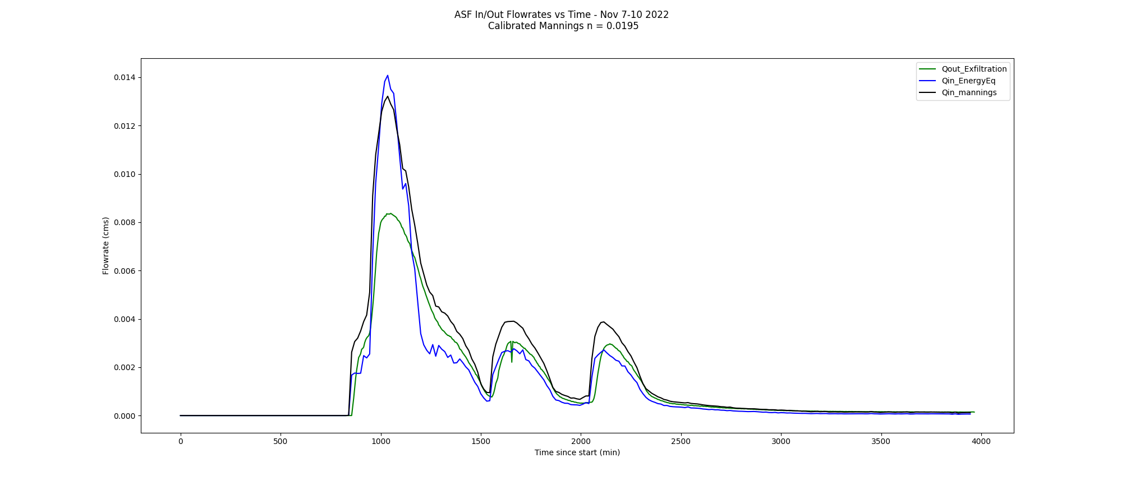
Calc Volume In (m³) = 309.15
Calc Volume Out = 293.05
Est Volume Retained = 16.1

Slide 2
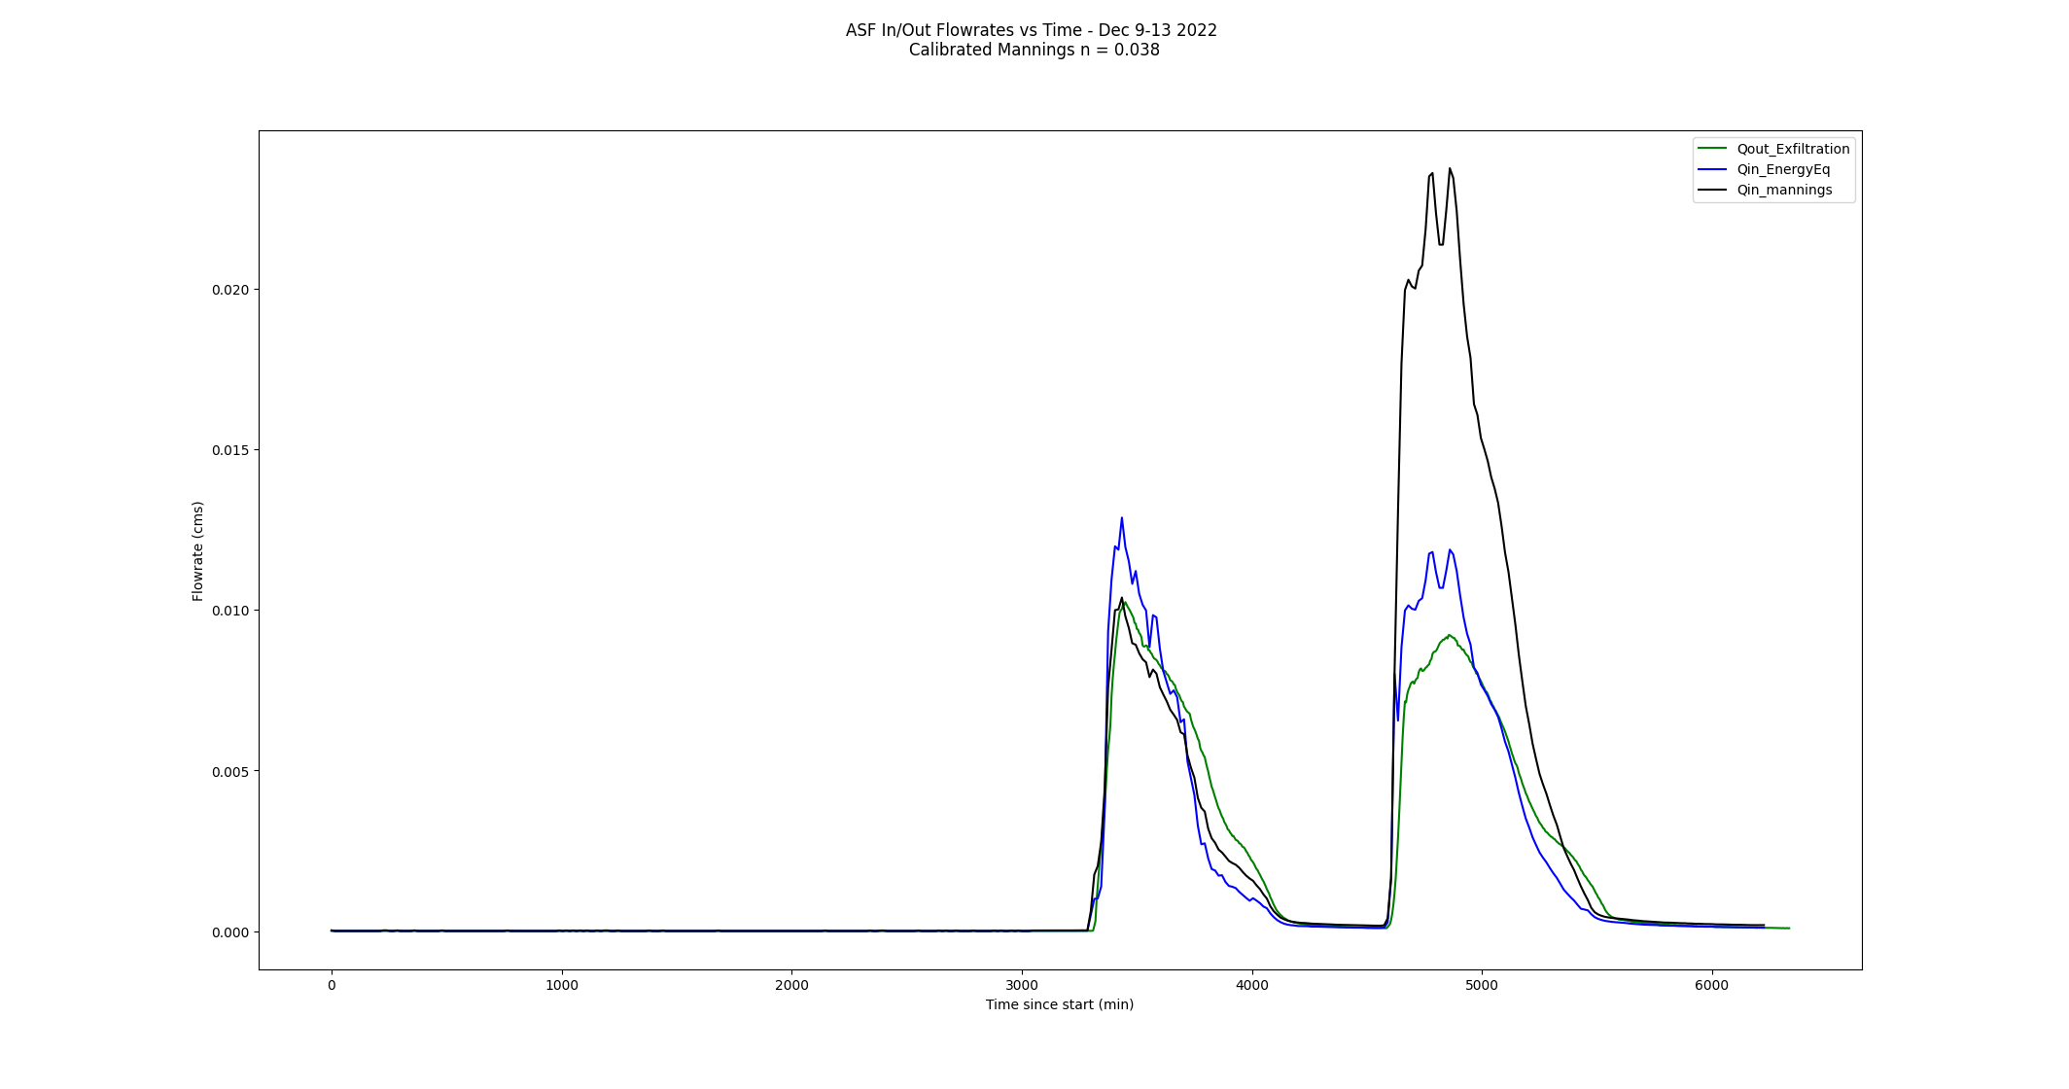
Calc Volume In (m³) = 598.5
Calc Volume Out = 582.4
Est Volume Retained = 16.1

Slide 3
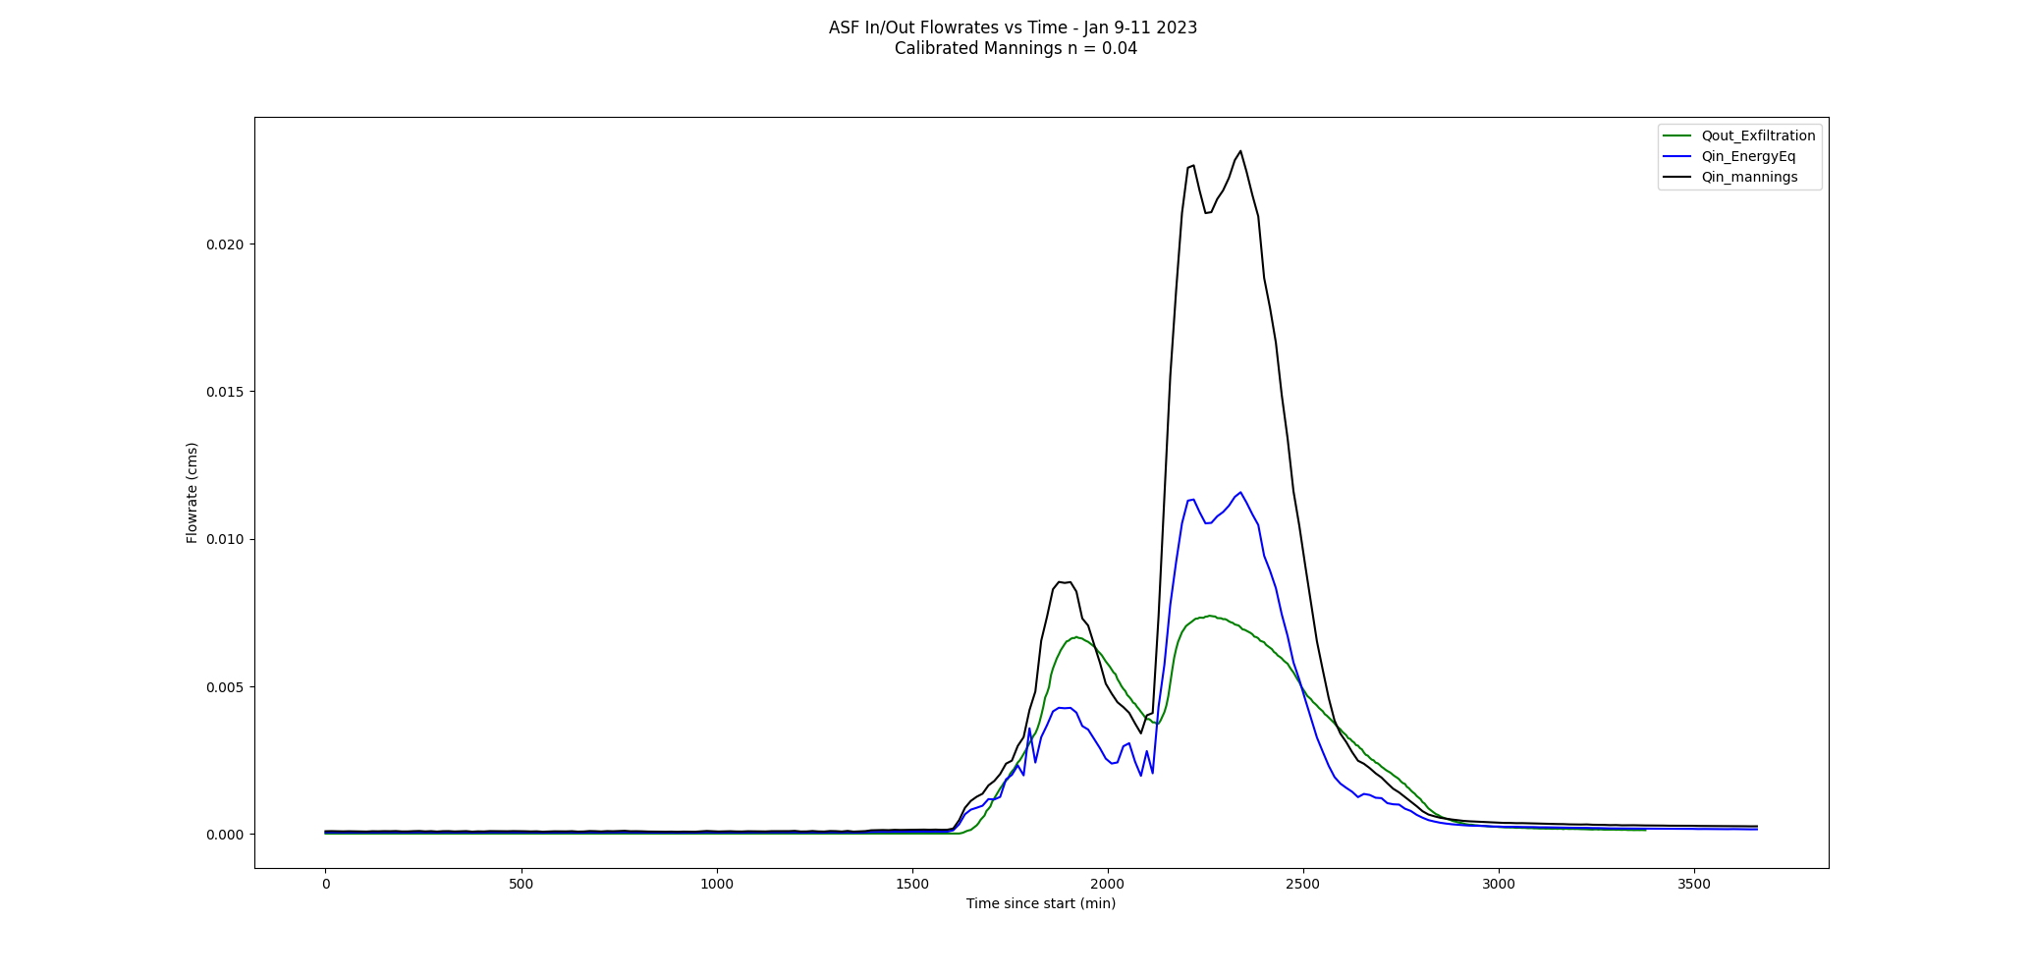
Calc Volume In (m³) = 337.4
Calc Volume Out = 321.3
Est Volume Retained = 16.1

Slide 4
Est Volume Retained = ASF Surface Area * Media Depth
* Assumed Porosity

